Slide 1
Linux device driver
Day 11 PPT
-SUBITHRA s

Slide 2
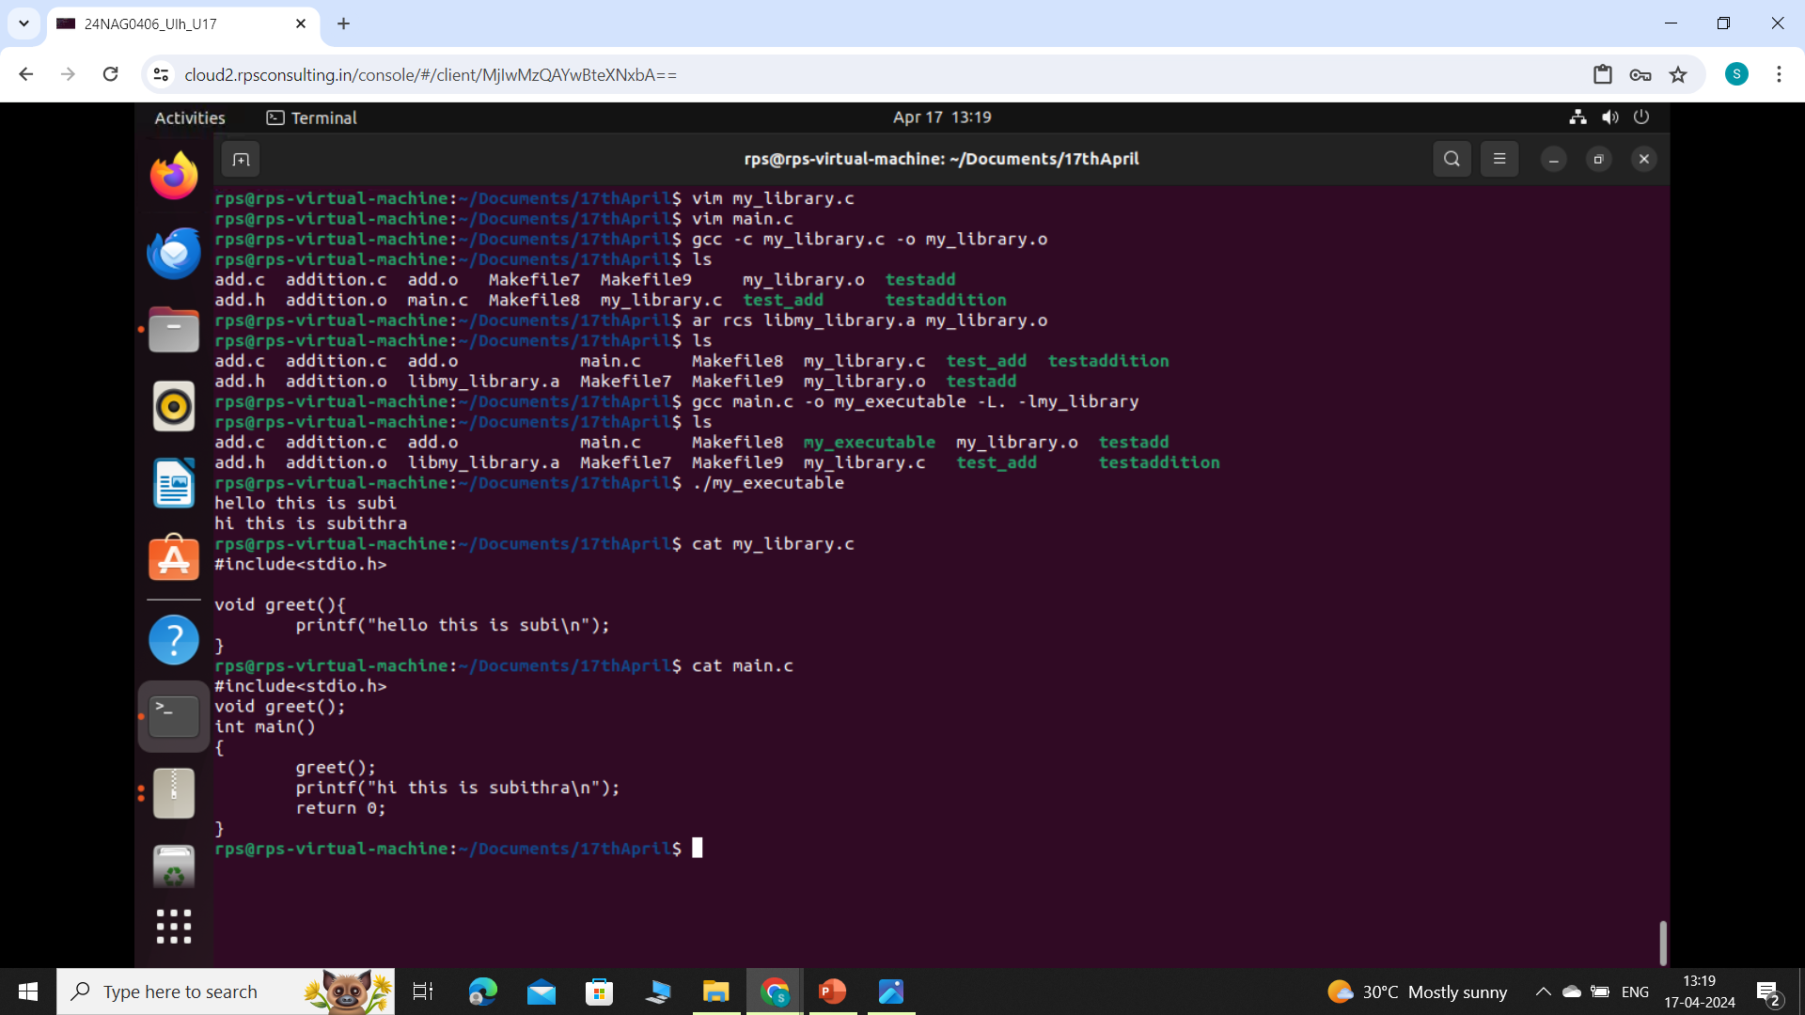
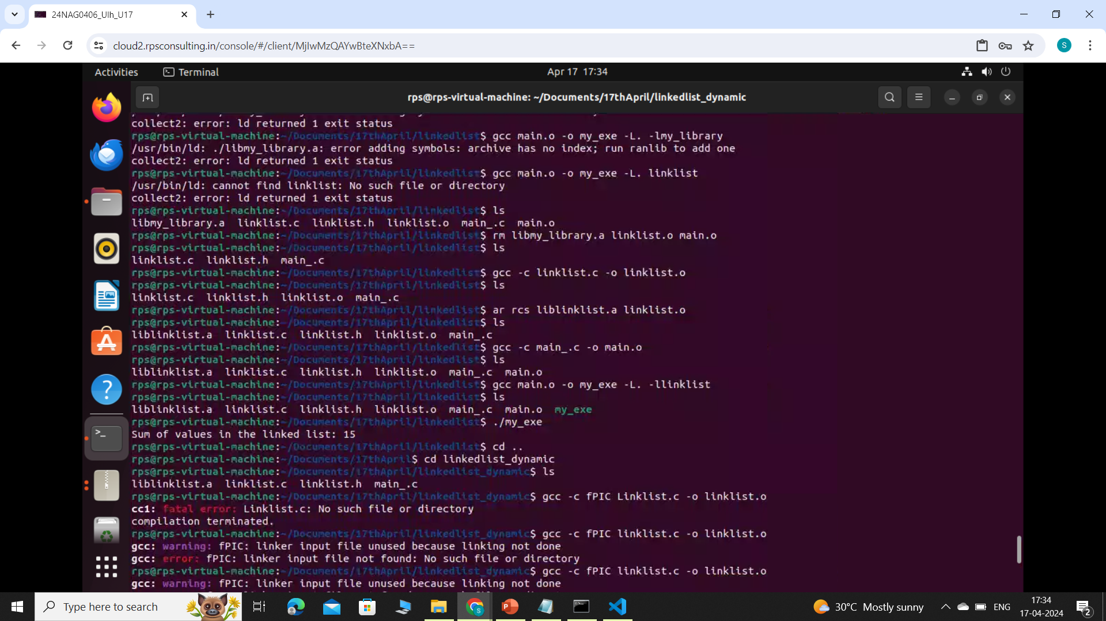
Creating and using static library
SINGLY LINKED LIST

Slide 3
Creating and using static library
create a static library (libmy_library.a) from my_library.o:
ar rcs libmy_library.a my_library.o
ar: archive command used to create, modify, and extract files from archives.
rcs: flags for ar command:
r: insert files into the archive (replace if they already exist).
c: create the archive if it doesn't exist.
s: write an index (symbol table) to the archive, which speeds up linking.
libmy_library.a: name of the archive/library being created.
my_library.o: object file to include in the library.
compile main.c and link it with libmy_library.a to create an executable (my_executable):

Slide 4
Creating and using static library
gcc main.c -o my_executable -l. -lmy_library
gcc: the gnu compiler collection, used for compiling and linking c code.
main.c: the main source file to be compiled.
-o my_executable: specifies the output file name (my_executable).
-l.: specifies the directory to search for libraries. here, it's the current directory (.).
-lmy_library: links against the library libmy_library.a. the -l flag indicates that gcc should search for a library named my_library, appending lib and .a to the given name.

Slide 5
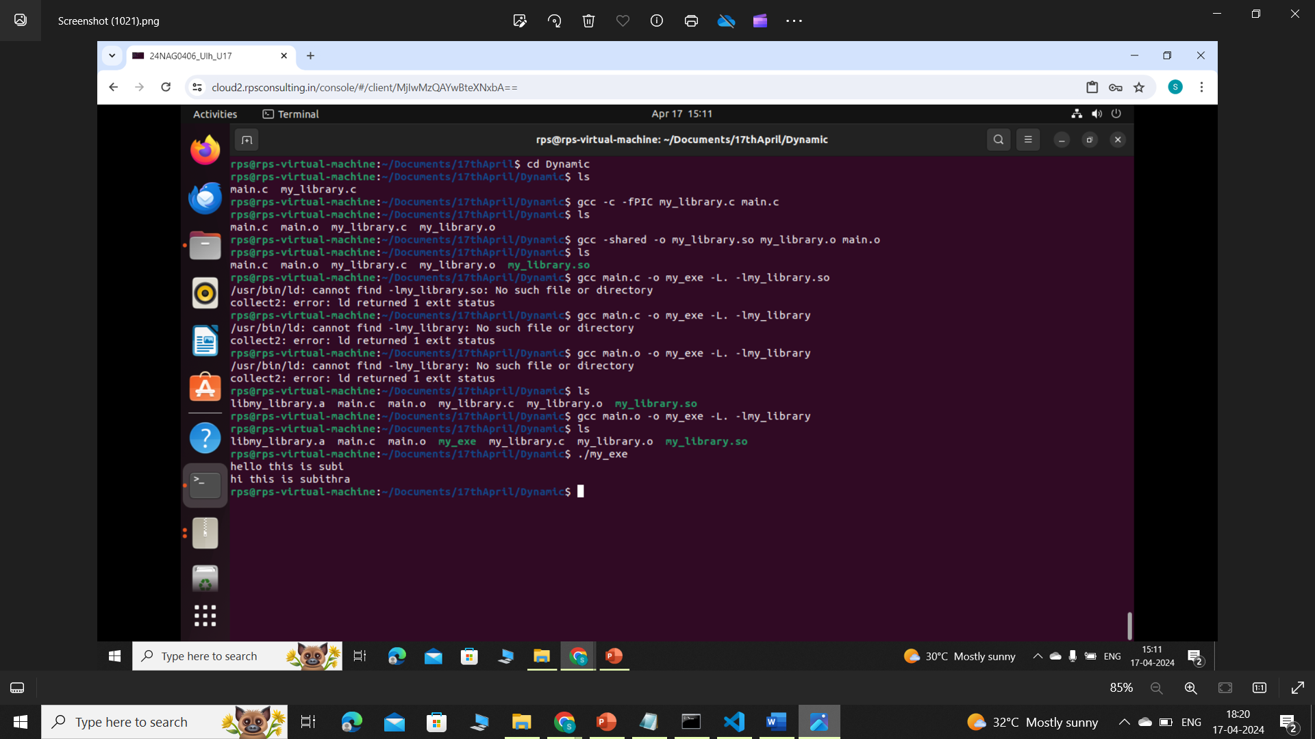
Creating and using DYNAMIC library
gcc -c -fPIC linklist.c main.c---fPIC flag is used to generate position-independent code, which is necessary for creating shared libraries.
gcc -shared -o liblink.so linklist.o main.o --- creates a shared library named linlink.so from the object file linklist.o and main.o
gcc main.o -o my_exe -L. -llinklist ---
-L. specifies the current directory.
-llinklist links against the library liblinklist.a. The -l flag indicates that gcc should search for a library named linklist, and it will automatically look for liblinklist.a
my_exe --- linked with the static library liblinklist.a, which contains the implementation of the linked list functions.
./my_exe --- for executing the file

Slide 6
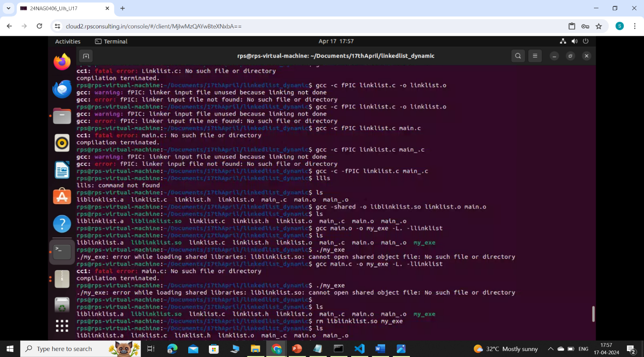
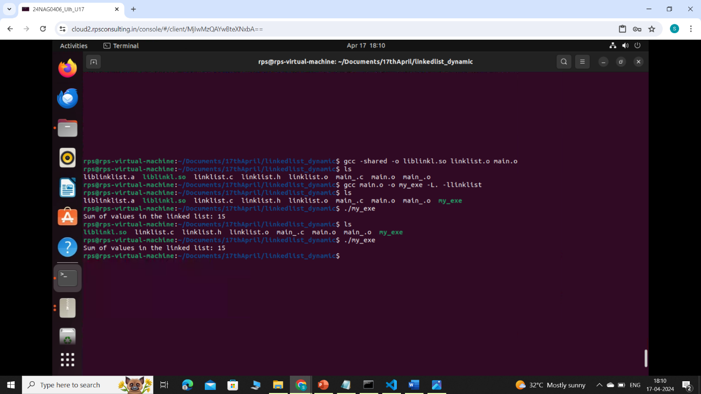
Creating and using DYNAMIC library
DOUBLY LINKED LIST

Slide 7
THANK YOU

